Slide 1
caAdapter Requirements – MirthConnect Capabilities Gap Assessment
Ekagra Software Technologies
October 22, 2010

Slide 2
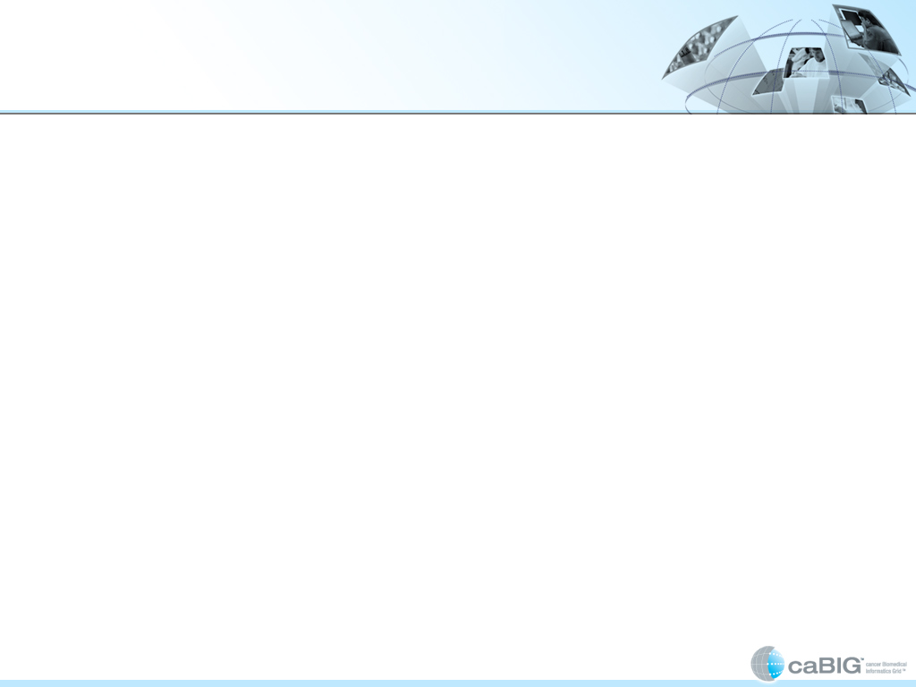

Objectives
Use caAdapter Requirements document as a reference and determine how many of the requirements can be met by MirthConnect
Conduct a Proof of Concept Test for Selected requirements
Ekagra

Slide 3
Mirth Basics
Mirth is an open source health care integration engine that supports the creation of interfaces, or channels, that perform message filtering, transforming, and routing between disparate systems
Channels are created & configured using the Mirth Administrator UI and are deployed to the Mirth Server
An integration scenario may involve creation and/or configuration of multiple channels
Each channel must have one source (referred to as source connector) and can have one or more destinations (referred to as destination connectors)
One or more filters/ transformations can be applied to each source and/ or destination connectors

Slide 4
caAdapter - Mirth Assessment
No. | caAdapter Requirement | Mirth Capability - Assessment
1. | On Launch, caAdapter shall display source, target, and mapping panels | On Launch of Mirth Administrator, dashboard will be displayed. User has to select the channel’s source or destination transformer window to see the source, target and mapping panels
2. | Open/ Close a Source/ target XML Schema File | Mirth Administrator will satisfy this requirement. Note: Mirth uses templates and not XML schemas for mapping.
3. | Simple, Parent-Child, Sibling and Conceptual Mapping | Simple Mapping supported out of the box Other mapping requirements can be supported by using JavaScript templates provided by Mirth In Mirth, there is no concept of an implicit relationship. All relationships must be explicitly defined using the templates.
4. | Map Elements Using Drag and Drop Action | Mirth Administrator UI will satisfy this requirement.
Ekagra

Slide 5
caAdapter - Mirth Assessment
No. | caAdapter Requirement | Mirth Capability - Assessment
5. | Delete Mapping Lines | Mirth Administrator will satisfy this requirement.
6. | Create, Edit and Save mapping file | Mirth Administrator will satisfy this requirement.
7. | Use Transformation Functions | New functions can be implemented in Mirth by writing JavaScript functions. Most of caAdapter functions (math, date, string, and constant) are also available out of the box in Mirth.
8. | Execute Data Transformation Using the UI | Transformation in Mirth can be performed in two ways: Mirth administrator lets a user deploy the mapped channel to the mirth server. The source connector will then read the message and the transformation begins per channel mapping. Messages can also be sent to a deployed channel dynamically using Mirth Administrator.
Ekagra

Slide 6
caAdapter - Mirth Assessment
No. | caAdapter Requirement | Mirth Capability - Assessment
9. | Create Target Data File Create transformed data file Progress Bar Logging Exception Handling | Mirth Administrator has different functionality with which this requirement can be met There is no progress bar capability but alerts can be set up to notify the user of success/failure. Mirth has a concept of alerts on channels, destination connectors, source and destination transformers. Based on the configuration, an email alert is sent. Logging can be viewed per channel, per source and/ or destination connectors in the channel. To invoke application API, you need to write java/JavaScript code and pass the transformed message into the code to invoke target API’s. Target API code can be wrapped into a JAR file and deployed to the mirth server. As stated earlier, templates and not XML schemas (XSD) drive mapping in Mirth.
Ekagra

Slide 7
caAdapter - Mirth Assessment
No. | caAdapter Requirement | Mirth Capability - Assessment
10. | Transform Data Using Java APIs | Mirth Channel configurations cannot be exposed as API’s. However, the configured mappings can be exposed as Service Operations (POC).
11. | Transform Data Using Webservice APIs | Mirth will satisfy this requirement. Mirth channels can be configured as SOAP (Web Service) Listeners. Once deployed, messages can be sent to this web service. Messages are transformed and sent to the destinations(s) as per the channel design. Channel can be configured to return the transformed message to the caller.
12. | Initiate Data Validation Operation from the caAdapter Webservice Portal/ API’s | Mirth satisfies this requirement with the help of filters. Additional channels can be configured to just do the data validation and return validation results.
Ekagra

Slide 8
caAdapter - Mirth Assessment
No. | caAdapter Requirement | Mirth Capability - Assessment
13. | Perform Data Validation on Transformed Data | Channels can be added to perform data validation on the transformed data.
14. | Return Data Validation Log File to User | Mirth satisfies this requirement with the help of Alerts. Mirth can also be configured to log message processing information, which can be viewed using the Mirth Administrator.
15. | Implement a Property File for UI Labels, Buttons, & Display Options | Mirth Administrator is implemented by the Mirth Developers using Java code. It is a Java Swing application. Upon source code review of Mirth 1.8.2, we found out that NOT all text displayed in the Mirth Administrator comes from the properties file. Some of the text is static (hard-coded).
Ekagra

Slide 9
caAdapter - Mirth
Data Formats Support - Comparison
Data Type | caAdapter | Mirth | Comments
XLS | √ | Χ | Mirth does support XLS saved as CSV but no direct support for XLS
CSV | √ | √ | caAdapter supports CSV in only source format & not target format
HL7v2 | √ | √ | caAdapter supports HL7v2 in only source format
HL7v3 | √ | √
XML | √ | √
CDA | Χ | Χ
CCD | Χ | Χ
PDF/ RTF | Χ | √ | Mirth can read but cannot parse a PDF file. However, Mirth can write a PDF file using data from all other accepted formats
X12, EDI, NCPCP, DICOM | Χ | √ | Mirth supports these data formats for both source and target
Ekagra
√ = Full Support, √ = Limited Support, Χ = No Support

Slide 10
caAdapter – Mirth
Connectors Support - Comparison
Data Type | caAdapter | Mirth | Comments
API | √ | Χ | Mirth cannot be embedded into an application. Also does not provide capability to invoke using API
Web Service | √ | √ | Mirth can accept a web service call and also able to invoke a target web service
Database | Χ | √ | Mirth provides Database Readers and Writers
JMS File HTTP DICOM LLP TCP JavaScript | Χ | √ | Mirth provides: JMS Readers and Writers File Readers and Writers HTTP Listeners and Senders DICOM Listeners and Senders LLP Listeners and Senders TCP Listeners and Senders JavaScript Readers and Writers
Document | Χ | √ | Mirth provides document writer in PDF and RTF formats
Email | Χ | √ | Mirth provides Email Sender
Ekagra
√ = Full Support, √ = Limited Support, Χ = No Support

Slide 11
Demo Scenarios
1. HL7v2 to HL7v3 Transformer and Stress Test
cmp Architecture_HL7v2_HL7v3
reads from
writes to file
«text file»
file system
«Mirth»
system
«xml file»
HL7v2
HL7v2 to HL7v3
Channel
HL7v3
2. Database to HL7v3 Transformer
cmp Database_to_HL7V3
reads from
writes to file
«PostgreSQL DB»
database
«Mirth»
system
«xml file»
Patient
Database to HL7v3
HL7v3
Channel
Ekagra

Slide 12
Demo Scenarios – contd.
Transformation Web Service
cmp TransformationService
MIRTH SERVER
Transformation Channels
if source is DELIMITED
and target is HL7V3
«channel»
web service call with
Delimited to HL7V3
Transform messages
payload to transform
using channels
if source is XML and
«SoapUI»
«SOAP Listen...
target is HL7V3
«channel»
«Mirth»
WebServiceClient
Transformation
XML to HL7V3
Administrator UI
transformed
Service Channel
message
other transformations
Other Transformation Channels
Ekagra

Slide 13
Conclusion
MirthConnect is an open-source, health care integration engine with several built-in data transformation capabilities that are in the core requirements for the caAdapter Common Mapping and Transformation Service
MirthConnect supports certain data transformations that are over and above the caAdapter Common Mapping and Transformation Service requirements
Mirth could be used to support these data transformation requirements as long as the API requirement is not critical for caAdapter
Notes From the Demo Meeting
caAdapter team made a note that performing complex mapping from HL7v2 to HL7v3 is relatively easy (few days) with caAdapter.
It is mutually agreed that for a non-experienced Mirth user, complex HL7v2 to HL7v3 mapping may take up to couple of weeks, because, JavaScript coding (using Mirth provided templates) is required

